Slide 2
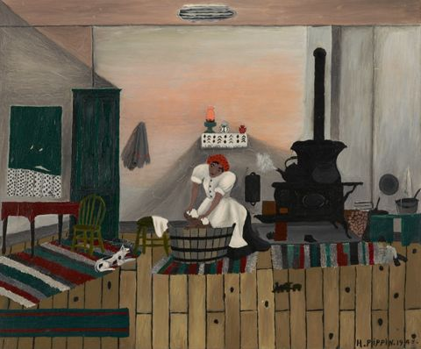
Activity
Image Source

Slide 3
Activity
What do you see when you look at this artwork?
What do you notice?
Spend 2 minutes noting down everything that you see in this image.
Image Source

Slide 4
Discussion
In pairs, spend 3 minutes discussing what you noticed?
Did you see different things?
Image Source

Slide 5
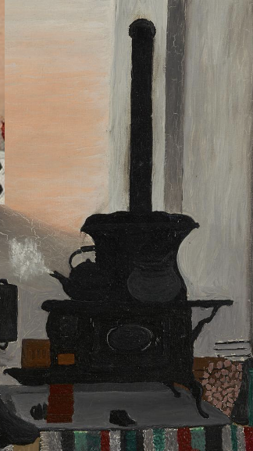
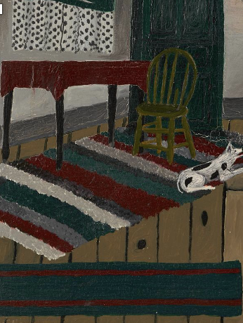
Image Source

Slide 6
Discussion
What do the things you noticed suggest?
What might the artwork mean?
Spend 5 minutes discussing your ideas.
Image Source

Slide 7
Research
A key component of Articulation is research. Research helps you to find out more about an artwork and form convincing arguments around your chosen object.
You might ask the following questions:
Who made the artwork?
When was the artwork made?
Where was the artwork made?
After this, you might ask:
What was the context the artwork was made in?
How does the artwork reflect the society or time it was created?
You can find out more information about your artwork in books, magazines or museum and gallery websites.

Slide 8
Activity
Spend 2-3 minutes reading the passage. Highlight any information that you think helps you understand the artwork.
Horace Pippin’s celebrated series of African American domestic interiors take viewers on a visual tour through the homes of ordinary African Americans as they go about the business of everyday living; for example […] Saturday Night Bath portrays a mother scrubbing a child in a washtub in front of the stove.
Pippin’s domestic scenes, which open to viewers the interior of African American homes and reveal his ability to interject subtle social commentary into his visual renderings of subject matter, show Pippin at his best. These images bring the viewer into a large common room that seems to be the hub of family activity and life. At the same time, the multiplicity of activities that occur in this single room suggests the cramped quarters in which many African American families found themselves in the North during the period of intense Northern migration. The economic condition under which these families lived in is indicated by the walls of the room, which invariably display areas in which the plaster has fallen away, indicating the deteriorating conditions of these homes. Despite these conditions, the rooms are depicted as extremely neat, orderly, and warm, symbolized by an ever-present coal-burning stove.
John W. Roberts, ‘Horace Pippin and the African American Vernacular’, Cultural Critique, 41 (1999), 5-36 (pp. 30-31).

Slide 9
Discussion
What did you highlight?
What information helped you to understand the artwork?
Spend 5 minutes discussing your ideas in pairs or small groups.
Horace Pippin, Saturday Night Bath (1945)
Image Source

Slide 10
Activity
Think back to the activities:
What did you notice?
What does this suggest?
Why is this important?
Spend 5 minutes to writing 2-3 sentences about this artwork thinking about these questions.
Horace Pippin, Saturday Night Bath (1945)
Image Source

Slide 11
Activity
A key element of Articulation is presenting your research.
Present your ideas to your partner. Remember:
Speak slowly and clearly
Try and get eye contact
Pause. If you need a break, take a breath, refocus and return to speaking
Horace Pippin, Saturday Night Bath (1945)
Image Source

