Slide 1





Mother Tongue
Other Tongue
2024

Slide 2

Mother Tongue Other Tongue is a multilingual poetry project, created as a Laureate Education Project by Professor Carol Ann Duffy DBE (UK Poet Laureate 2009-2019) to celebrate cultural diversity and the many languages spoken in schools across the UK. This initiative originally began running in the North West, coordinated by the Manchester Poetry Library at Manchester Metropolitan University.
As part of Leeds Language Week, the University of Leeds, Routes into Languages Yorkshire and Humberside, and the Camões Centre for Portuguese Language at the University of Leeds hosted two separate poetry competitions. The winning entries have been published here in the Mother Tongue Other Tongue digital anthology.

Slide 3

Mother Tongue

Slide 4

Mother Tongue
Mother Tongue invites young people to share poems and songs in a language they regard as their mother tongue.
These can be poems that they have found, or that they remember from childhood, or that others have shared with them. Or they can be original and written by the young person in their mother language.
We asked everyone to say something about why they wanted to share their particular poem, published here in italics.

Slide 5







This year our winners spoke seven different languages!
Korean
Mandarin Chinese
Shona
Hungarian
Bahraini Arabic
Russian
Malayalam

Slide 6

Congratulations to all our Mother Tongue 2024 winners!

Slide 7
Banzu Zairah Harees (Year 10)
Horizon Community College
Malayalam
Ente Bhasha
സന്നികൃഷ്ടാബ്ദിതന്‍ ഗംഭീരശൈലിയും
സഹ്യഗിരിതന്‍ അടിയുറപ്പും
ഗോകര്‍ണ്ണ ക്ഷേത്രത്തിന്‍ നിര്‍വൃതികൃത്വവും
ശ്രീകന്യമാലിന്‍ പ്രസന്നതയും
ഗംഗപോലുള്ള പേരാറ്റിന്‍ വിശുദ്ധിയും
തെങ്ങിളം കായ്നീരിന്‍ മാധുര്യവും
ചന്ദനൈലാലവങ്കാദിവസ്തുക്കള്‍ തന്‍
നന്ദിത പ്രാണമാം തൂമണവും
സംസ്കൃത ഭാഷതന്‍ സ്വാഭാവികൌജസ്സും
സാക്ഷാല്‍ തമിഴിന്റെ സൌന്ദര്യവും
ഒത്തുചേര്‍ന്നുള്ളൊരു ഭാഷയാണെന്‍ ഭാഷ
മത്താടി കൊള്‍കയാണഭിമാനമേ നീ
മിണ്ടി തുടങ്ങാന്‍ ശ്രമിയ്ക്കുന്ന പിഞ്ചിളം
ചുണ്ടിന്മേല്‍ അമ്മിഞ്ഞാ പാലോടൊപ്പം
അമ്മയെന്നുള്ള രണ്ടക്ഷരമല്ലയോ
സമ്മേളിച്ചിടുന്നതൊന്നാമതായ്
മറ്റുള്ള ഭാഷകള്‍ കേവലം ധാത്രിമാര്‍
മര്‍ത്യനു പെറ്റമ്മ തന്‍ ഭാഷതാന്‍
മാതാവിന്‍ വാത്സല്ല്യ ദുഗ്ദം പകര്‍ന്നാലെ
പൈതങ്ങള്‍ പൂര്‍ണ്ണ വളര്‍ച്ച നേടൂ
അമ്മതാന്‍ തന്നെ പകര്‍ന്നു തരുമ്പോഴെ
നമ്മള്‍ക്കമൃതുമമൃതായ് തോന്നൂ..
By Vallathol Narayana Menon (Malayalam)
I’ve chosen this poem because it has been written by a famous Indian poet. It is a poem in my mother tongue which talks about love of a beautiful, sacred language and identity. It reminds me about India, about everything what I miss; hearing different languages on the streets and the unique culture they are embedded in, food, exotic but at the same time familiar smells, different places, which I’ve been exploring with my family. It also reminds me of my school in India and my friends because we were reading this poem at school.
Mother Tongue

Slide 8
Spread the love
Sannikrishtabdithan Gambhirasaili too
Sahyagirithan will be established
Gokarna Temple's restoration
The happiness of Srikanyamalin
And peratin sanctity like the Ganges
And the sweetness of coconut water
Chandanailalavankadiduthithan
Nandita Pranamam and Tumanam
A Sanskrit speaker is a natural genius
Truly the beauty of Tamil
A language is a collective language
You are proud of Mathadi Kolkayan
Pinchilam trying to start talking
With mother's milk on the lips
Amma is not two letters
Gathering is the first
Other languages ​​are simply dhatris
Petamma is his language for a mortal
Matavin watsallya dugdam pakarnale
May the children grow up fully
When the mother pours it herself
Feel dead to us..
By Vallathol Narayana Menon (Malayalam)
Banzu Zairah Harees (Year 10)
Horizon Community College
Malayalam
I’ve chosen this poem because it has been written by a famous Indian poet. It is a poem in my mother tongue which talks about love of a beautiful, sacred language and identity. It reminds me about India, about everything what I miss; hearing different languages on the streets and the unique culture they are embedded in, food, exotic but at the same time familiar smells, different places, which I’ve been exploring with my family. It also reminds me of my school in India and my friends because we were reading this poem at school.
Mother Tongue

Slide 9
Lara Kiss (Year 9)
Horizon Community College
Hungarian
Tavaszi szél vizet áraszt
Tavaszi szél vizet áraszt,
virágom, virágom.
Minden madár társat választ,
virágom, virágom.
Hát én immár kit válasszak,
virágom, virágom.
Te engemet, én tégedet,
virágom, virágom
Zöld pántlika, könnyű gúnya,
Virágom, virágom,
Mert azt a szél könnyen fújja,
Virágom, virágom.
De a fátyol nehéz gúnya,
Virágom, virágom,
Mert azt a bú foldig húzza,
Virágom, virágom.
Spring Breeze Blows the Water
Spring breeze blows the water
my flower, my flower
every bird picks a partner
my flower, my flower
So who should I choose now,
my flower, my flower
you pick me and I´ll pick you,
my flower, my flower
Green hair ribbon, simple dress
my flower, my flower
because the wind can easily
ruffle it,
my flower, my flower
But the veil´s a heavy burden
my flower, my flower
because the sadness pulls
it down,
my flower, my flower.
This a Hungarian folk song/poem for children. It talks about young love and marriage. Some versions change the last verse/stanza to a happy ending where they fall in love while others end with a tale of forced marriage like the one above. Although it is a sad poem it makes me feel happy to know that times have changed and now there are a lot fewer forced marriages and more for love.
Mother Tongue
(Hungarian)

Slide 10
Alisa Gubareva (Year 12)
Nicholas Breakspear Catholic School
Russian
Человеку надо мало: чтоб искал ...
Человеку надо мало:
чтоб искал и находил.
Чтоб имелись для начала
Друг -
один
и враг -
один...
Человеку надо мало:
чтоб тропинка вдаль вела.
Чтоб жила на свете
мама.
Сколько нужно ей -
жила.
Человеку надо мало:
после грома - тишину.
Голубой клочок тумана.
Жизнь -
одну.
И смерть -
одну.
Утром свежую газету -
с Человечеством родство.
И всего одну планету:
Землю!
Только и всего.
И -
межзвездную дорогу
да мечту о скоростях.
Это, в сущности,-
немного.
Это, в общем-то,- пустяк.
Невеликая награда.
Невысокий пьедестал.
Человеку
мало
надо.
Лишь бы дома кто-то
ждал
Unlike prominent philosophers with their vast memoirs devoted to the purpose of human life, Rozhdestvensky firmly declares in the simple title: "Man needs little." Every person at some point in their life considers the boundless question "What is the meaning of life?". In this poem Rozhdestvensky discusses what makes a person truly content.
In the first part of the work, the micro-theme of friendship can be highlighted. Its position in the poem shows that the author regards friendship to be the most substantial value.
People want their lives to be fast-paced, every day to be bright, every moment unforgettable. But there is a danger that a person will gain too much speed and lose strength ahead of time. It should be remembered that after adventure there should be rest, «peace that follows stormy days». The image of this natural phenomenon symbolizes the noise that so often fills our lives.
Mother Tongue
(Original poem in Russian by Robert Rozhdestvensky)

Slide 11
Alisa Gubareva (Year 12)
Nicholas Breakspear Catholic School
The author shows that a touch of mystery and suspense creates interesting moments in life using the imagery of fog, commonly known as a symbol mystery, the unknown.
Next, the author changes the focus to the balance of good and bad. By contrasting life with death, he shows the inseparability of their existence. He is saying that you don't have to live forever to be happy. It is enough for a person to live one eventful life.
one life
and just one death.
The syntactic parallelism of these sentences shows the connection between the concepts of life and death.
In the morning, a fresh newspaper –
kinship with Humanity.
Here, the newspaper symbolizes the connection between man and society, highlighting the need for friendship all people have.
The last lines of the poem are short and concise:
A person doesn't need much.
If only someone was waiting at home.
The author uses the pronoun "someone". In my opinion, this is how he wants to say that this person can be anyone: family member or friend.
In my opinion, the idea of R. Rozhdestvensky's poem "A man needs little ..." is that it is very simple to become happy: you do not need to have material goods for this, it is available to everyone. You need to look for happiness not in something global, distant, but in simple, seemingly mundane things.
Mother Tongue

Slide 12
Alisa Gubareva (Year 12)
Nicholas Breakspear Catholic School
Just to Look...
One, indeed, needs very little:
Look and find it in the end.
To begin with, one needs people:
just one foe
and just
one
friend.
One, indeed, needs very little
Just a path to take one's leave,
and one's wish is very simple
He just wants
his mom
to live.
One, indeed, needs very little:
peace that follows stormy days.
Just some fog and stars that twinkle,
just
one life
and just one death.
One just needs a morning paper,
With mankind the kinship bonds.
Just one planet, love and favour,
Mother Earth!
That's all one wants.
Plus
an interstellar road and
dream of flying and high speed.
That's a trifle, not important,
That's not very much, indeed.
Not a big award and wholly
negligible podium.
One
does not need much
if only
he'd be waited for
at home.
This semantic field of simplicity is achieved using the words "few", "one", "a little", "small", "low". The abruptness of the short sentences further emphasizes this idea of simplicity.
The main idea of the poem is "to have someone waiting at home." This seemingly straightforward conclusion is the main idea of the work. Most people don't even realize that all their suffering stems from loneliness and isolation. This idea is especially relevant in modern society, where many are so immersed in their problems that they forget the value of living in a community.
Mother Tongue
(English version, translated by Alec Vagapov )

Slide 13

Charlie Fall (Year 7)
Horizon Community College
Mandarin Chinese
Mother Tongue

Slide 14
my little girl, please sleep, come on sleep
حلا:مابي
mabi
I don’t want to
مشاعل:يمي نام الله يهديك يمى نام يلله
yumma name Allah yhadeek, Yumma Nami yalla
my little girl, please sleep, come on sleep
حلا:مابي......لو تبيني مني آآنام يلا نامي جمبي
mabi… lu tabeen anam yala name janbi
I don’t want to… if you want me to sleep then come and sleep next to me
مشاعل:مابي
mabi
I don’t want to
حلا:لو تبيني اني آآنام يلا جمبي
lu tabeen anam yala name janbi
if you want me to sleep then come and sleep next to me
مابي مابي مابي مابي مولازم انام انا آخاف أخاف اخاف لحالي أخاف انام
mabi mabi mabi mabi mu lazim anam, ana a5af, a5af a5af l7ali a5af anam
I don’t want, I don’t want to sleep, im afraid, im afraid to sleep on my own
مابي مابي مابي مابي مولازم انام انا آخاف أخاف اخاف لحالي أخاف انام
mabi mabi mabi mabi mu lazim anam, ana a5af, a5af a5af l7ali a5af anam
I LOVE YOU MAMA
I.....l....0....v.....e...y....o...u... .m...a...m. ..a
I..l..o..v..e..y..o..u..m..a..m..a
I love you mama mama
معاشل:بنيتي الحبوبه
bnaity el7abooba
my lovely girl
حلا :انا
ana
that’s me
مشاعل:حلوة وطيوبه
7elwa o 6ayooba
beautiful and kind
حلا:انا
ana
that’s me
مشاعل:لما ابيها تنام تمسك ايديا
lama abeeha tnaam tamsik eideiya
when I want her to sleep, she holds on to my hand
حلا:انا
ana
that’s me
مشاعل:وتطلب هاديه
o ta6lib hadeya
and she asks for a present
حلا:ماما
mama
oh mom!
مشاعل:يمى نام الله يهديك يمي نامي يلله
yumma name Allah yhadeek, Yumma Nami yalla
I don’t want, I don’t want to sleep, im afraid, im afraid to sleep on my own
حلا:Ilove you mama mama
مشاعل:Ilove you 2 mama
مشاعل:بروحي اضمك
brou7i a’6imik
I hold you within my soul
حلا:انا
that’s me
مشاعل:عسل يا عالم عسل....مافي مثلها
3asal ya 3alam 3asal, mafi mithilha
she’s like honey, oh world she is like honey. There’s nobody like her
حلا:ماما
oh mom
مشاعل:ودي آكلها
weddi aakelha
I feel like eating her up
حلا:ماما
mama
oh mom
مشاعل:يمي نام الله يهديك يمى نام يلله
yumma name Allah yhadeek, Yumma Nami yalla
my little girl, please sleep, come on sleep
حلا:مابي
mabi
I don’t want to
حمشاعل:يمي نام الله يهديك يمى نام يلله
حyumma name Allah yhadeek, Yumma Nami yalla
my little girl, please sleep, come on sleep
حلا:مابي......لا بغني اغنيه وحده وانتي سمعي يلا
mabi. La ba’3ani ‘3neya wa7da winti sim3ay yalla
I don’t want… ill just sing one song and you listen ok
مشاعل:يلاه
yalla
go on then…
حلا:لا بغني اغنيه وحده وانتي سمعي يلا.....اوووف وميجانا ويا مال قولو يا سلام
La ba’3ani ‘3neya wa7da winti sim3ay yalla … uuff, o meijana, o ya maal… golo ya salam
ill just sing one song and you listen ok… Off, meijana, O Ya Maal (different traditional songs) everybody say “Ya Salaaam” (meaning, oh amazing)
مشاعل:يا سلام
Ya Salaam
”Ya salaam”
حلا:اووووف اوووف اوووف اوووف يا سلام
offff off off offff ya salam
oh how amazing is this
مابي مابي مابي مابي مولازم انام انا آخاف أخاف اخاف لحالي أخاف انام
mabi mabi mabi mabi mu lazim anam, ana a5af, a5af a5af l7ali a5af anam
I don’t want, I don’t want to sleep, im afraid, im afraid to sleep on my own (repeated twice)
ماماه....ماماه.....ماماه....يلا روحي نامي حبيبتي..
mama, mama, mama, yalla roo7i name 7abibti ..
mom, mom, mom (she’s waking up her mother coz the mom fell asleep but she didn’t)… go on my love go to sleep (telling her mom to go to her room and sleep)
Diala Ahmed (Year 7)
Horizon Community College
Bahraini Arabic
I chose this song because it reminds me of my childhood back in my home country.
It was also really popular for many generations and sends a deeper meaning of always loving your mum because she has done a lot for you and you should thank her for that, by using this song, or it could be a reminder of your mum which is the reason why I also chose it because it’s a really joyful, beautiful song in general.
Mother Tongue
By Hala Al Turk (Bahraini Arabic)

Slide 15
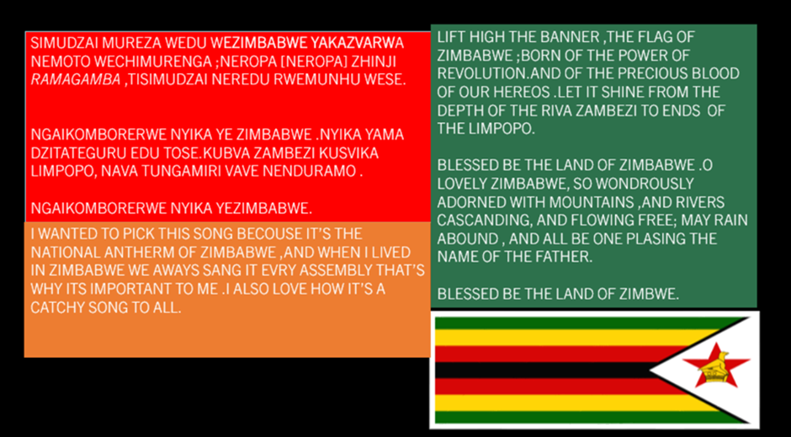
Judith Nyati (Year 7)
Horizon Community College
Shona
Mother Tongue

Slide 16
Nhai ndotangira papi
Kubva kunzvimbo dzinoshamisa dzechisirwo kusvika kumagariro ake akapfuma, Zimbabwe inobata mukati mayo runako runoshamisa rusina kujaira mune imwe nyika ipi zvayo. Zvamazvirokwazvo Rinoropafadzwa namakomo makuru, nzizi dzinopfachukira dzinoyerera dzakadzika uye dzakafara neibvu runokosheswa nevagari vemo zvakare nevatorwa. Ndirimugari wenhaka anozvikudza wezviwanikwa zvake; Mugadziri uye anotora chikamu mutsika nemagariro ake ane simba. Ndinonzwa kukudzwa kuva muZimbabwe uye kudaidza kuti Zimbabwe yakanaka, musha wangu.
Written by Lynne Mushambi (Shona)
Lynne Mushambi
(Year 7)
Horizon Community College
Shona
POEM : MY COUNTRY
English
Oh, where to start
From her beautiful natural wonders to her rich culture, Zimbabwe holds within her boarders striking beauty unaccustomed to any other land.
Indeed, she is blessed with her mighty mountains, cascading rivers that flow deep and wide, and fertile lands savored by the locals and foreigners from all over the globe
I am a proud inheritor of her natural resources; A creator of and participant in her vibrant traditions and cultures. I feel proud to be Zimbabwean and honored to call wondrously lovely Zimbabwe my home.
Mother Tongue

Slide 17
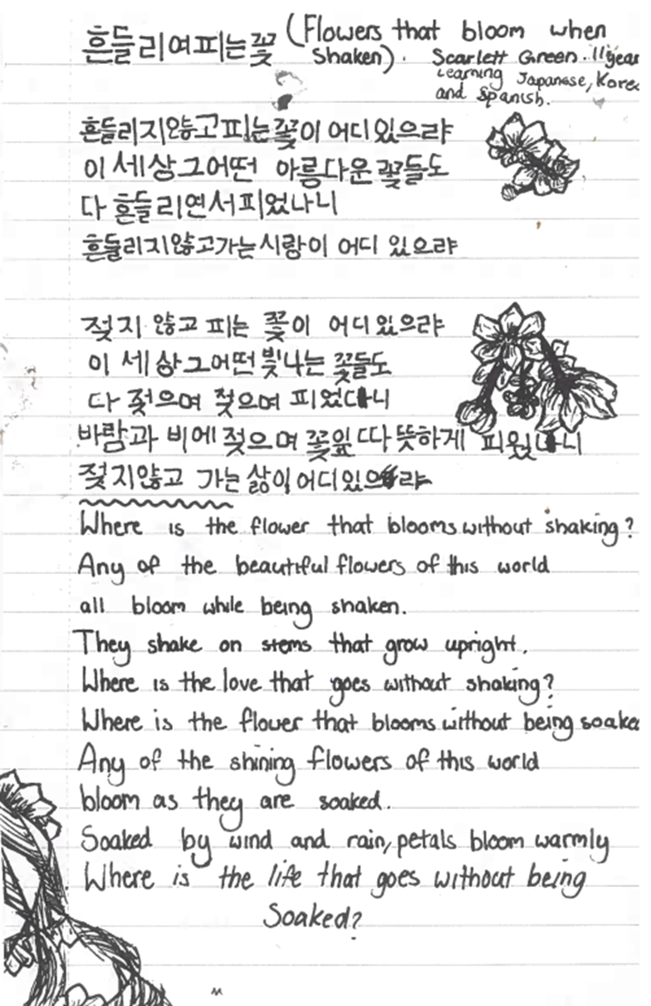
Scarlett Green (Year 7)
Horizon Community College
Korean
This poem makes me feel upset but as it moves further along into the poem it makes me feel sympathy for nature and makes me realise how much the earth goes through but still remains.
Mother Tongue

Slide 18
Other Tongue

Slide 19
Other Tongue
Other Tongue invites young people to be creative in a language they are learning by creating an original poem or a song.
These poems were read by native speakers of the language, who have shared their comments about the poems and what they liked about them.
We asked everyone to say something about why they wanted to share their particular poem, published here in italics.

Slide 20

This year our winners spoke five different languages!
German
Portuguese
Welsh
Polish
Spanish

Slide 21
Congratulations to all our Other Tongue 2024 winners!

Slide 22
Other Tongue
Gio (Aged 14)
Leeds City Academy
Portuguese
A poem about my brain, day to day.
A fallen land
Penso no meu cérebro como a fallen land
Estruturas faltando ou pessoas brigando
Gosto de pensar no meu cérebro em três secções
Como as rodas de um triciclo.
Primeiro, a roda da frente:
Aquela que mantém os pensamentos fluindo,
A parte que uso para organizar os meus pensamentos
Para que eles não se enrosquem
Penso neles como um barco a remo,
Sem o remo na água não estava remando.
Segundo, a roda de trás na esquerda do triciclo:
Aquela que contém as emoções.
Esta roda é importante porque
Tem uma visão mais clara.
Por padrão, isso me faz dar muita devoção.
E também é agradável quanto uma caminhada de verão
Que pára abruptamente devido a um obstrutor.
Finalmente, a roda de trás da direita do triciclo:
Aquela que toma medidas
E aquela que executa o plano em mente e o faz ser visto.
E como lidar com um grupo, embora não a equipe completa,
Eles ainda são uma fração.
Então segundo a ponta da roda e o triciclo.

Slide 23
Other Tongue
Leandro and Lolita (Year 10)
Leeds City Academy
Portuguese
School days
Olá somos estudantes de Leeds City Acaddemy.
Todos os dias
de segunda a sexta vamos à escola
Para poder aprender
as coisas que podemos aprender no futuro
E como podemos gerir o nosso dinheiro
E como ser independente
Na escola também tem professores
Que ajudam muito
E temos muitas prendas
This poem describes our school in Leeds and how the teachers are supportive and how we can prepare for life here.

Slide 24
Other Tongue
Victória Martinho Vieira da Cunha (Aged 10)
St Margaret’s Primary School
Portuguese
Nada
Nada é nada
O que significa nada?
Não há nada de nada!
Sei lá o que é nada
À parte de ser nadíssima.
Porque...
Nada é nada
E não é minha culpa,
Por isso desculpa!
I wrote this poem to be a rap song about the idea of “nothing”.

Slide 25
Mae bys Meri-Ann wedi brifo,
A Dafydd y gwas ddim yn iach.
Mae'r baban yn y crud yn crio,
A'r gath wedi sgramo Joni bach.
Sosban fach yn berwi ar y tân,
Sosban fawr yn berwi ar y llawr,
A'r gath wedi sgramo Joni bach.
Dai bach y soldiwr,
Dai bach y soldiwr,
Dai bach y soldiwr,
A chwt ei grys e mas.
Mae bys Meri-Ann wedi gwella,
A Dafydd y gwas yn ei fedd;
Mae'r baban yn y crud wedi tyfu,
A'r gath wedi huno mewn hedd.
Sosban fach yn berwi ar y tân
Sosban fawr yn berwi ar y llawr
A'r gath wedi huno mewn hedd.
Dai bach y sowldiwr,
Dai bach y sowldiwr,
Dai bach y sowldiwr,
A chwt ei grys e mas.
Aeth hen Fari Jones i Ffair y Caerau
I brynu set o lestri de;
Ond mynd i'r ffos aeth Mari gyda'i llestri
Trwy yfed gormod lawer iawn o "de"
Sosban fach yn berwi ar y tân
Sosban fawr yn berwi ar y llawr
A'r gath wedi huno mewn hedd.
Other Tongue
Ivy Dawson (Year 6)
St Margaret’s Primary School
Welsh
When you hear this song it sounds quite soothing and relaxing but actually is about a mum in a kitchen and everything is going wrong at home. Mary Ann has hurt her finger, the servant sent well, the baby is crying and the cat scratched Jony, a saucepan is boiling on the fire. So not very relaxing at all.
The reason I want to share it is because my nan (grandma) used to sing it to me when I was little to make me go to sleep. So when I hear it now I feel a connection with the Welsh side of my family and brings back so many memories. My mum and all her family grew up in the Wales although my grandad isn’t from Wales. His mum (my grandma) was and also it is a very known song, not only sung as a lullaby but also at rugby matches. Although we don’t speak Welsh at home sometimes we say “nosdâ” which means good night and other words.

Slide 26
Other Tongue
Oliver Hermoso-Barner (Year 6)
St Margaret’s Primary School
Spanish
Mi familia: la luz de mi vida
Mi familia: la luz de mi vida.
Mi hermano: un chico muy loco
Mi mamá: una campeona de la ayuda
Y mi papá: loco y estricto a la vez.
Mi familia: la luz de mi vida.
Mi abuelo: muy, muy feliz
Mi abuela: la maestra de la casa
Y mi tito: viene a hablar conmigo.
Mi familia: la luz de mi vida.

Slide 27
Other Tongue
Alana (Aged 14)
Leeds City Academy
Portuguese
A poem about love.
Amor
Algo tão bom e simples
Mas tão doloroso e trágico
Romeu e Julieta tentaram
Mas nem o tempo tentou
Só porque não vale a pena
Por que não tentaria
Vida
Só se vive uma vez
Faça-a memorável

Slide 28
Other Tongue
Ava Rothery (Year 7)
Horizon Community College
Spanish
Lugares
Lluvia y granizo,
Frio y nieve,
Son buenas excusas para no ir.
Rain and hail,
Cold and snow,
They are good excuses not to go.
This poem is short and simple because it describes how the weather is and why you shouldn’t do something or go out.

Slide 29
Other Tongue
Ava Rothery (Year 7)
Horizon Community College
Spanish
Abrir un libro
Abrir un libro,
Y encontrarás,
Personas y lugares de todo tipo,
Abrir un libro,
Y tú puedes ser,
Todo lo que quieras ser,
Abrir un libro,
Y puedes compartir,
Palabras maravillosas que puedes encontrar allí,
Abrir un libro,
Y yo también lo hare,
Me lees,
¡Y te leeré!
Open a book,
And you will find,
People and places of all kinds,
open a book,
And you can be,
Everything you want to be,
open a book,
And you can share,
Wonderful words you can find there,
open a book,
And I will too,
you read me,
And I will read you!
I like this poem because it links to school and how interested you can be in a book.

Slide 30
Las manos de mi madre by Alfredo Espino
Manos las de mi madre, tan acariciadoras,
tan de seda, tan de ella, blancas y bienhechoras.
¡Solo ellas son las santas, solo ellas son las que aman,
las que todo prodigan y nada me reclaman!
¡Las que por aliviarme de dudas y querellas,
me sacan las espinas y se las clavan en ellas!
Para el ardor ingrato de recónditas penas,
no hay como la frescura de esas dos azucenas.
¡Ellas cuando la vida deja mis flores mustias
son dos milagros blancos apaciguando angustias!
Y cuando del destino me acosan las maldades,
son dos alas de paz sobre mis tempestades.
Ellas son las celestes; las milagrosas, ellas,
porque hacen que en mi sombra me florezcan estrellas.
Para el dolor, caricias; para el pesar, unción;
¡Son las únicas manos que tienen corazón!
(Rosal de rosas blancas de tersuras eternas:
aprended de blancuras en las manos maternas).
Yo que llevo en el alma las dudas escondidas,
cuando tengo las alas de la ilusión caídas,
¡Las manos maternales aquí en mi pecho son
como dos alas quietas sobre mi corazón!
¡Las manos de mi madre saben borrar tristezas!
¡Las manos de mi madre perfuman con terneza!
Other Tongue
Claudia Marroquin (Year 11)
Horizon Community College
Spanish
My mother's hands
My mother's hands, so caressing,
so silky, so hers, white and benevolent.
Only they are the saints, only they are the ones who love,
who give everything and demand nothing from me!
Those who, to relieve me of doubts and quarrels,
take out my thorns and stick them in themselves!
For the ungrateful ardour of hidden sorrows,
there is nothing like the freshness of those two lilies.
When life leaves my flowers withered,
they are two white miracles calming anguish!
And when the evils of destiny harass me,
they are two wings of peace over my storms.
They are the celestial ones; the miraculous ones, they,
because they make stars bloom in my shadow.
For pain, caresses; for sorrow, anointing.
They are the only hands that have a heart!
(Rosebush of white roses of eternal smoothness:
learn of whiteness in the hands of my mother).
I who carry in my soul the hidden doubts,
when I have the wings of illusion fallen,
The maternal hands here in my chest are
like two quiet wings over my heart!
My mother's hands know how to erase sadness!
My mother's hands perfume with tenderness!
This poem is very important for me because it has been written by a poet from El Salvador, a country I’m from and where the official language is Spanish – a language which I am also studying at GCSE. The author writes about a mother, about his love for her. The poem talks about mum’s hands, which reminds me about my mum and her hands, which are always busy because she looks after me and my family. Like in the poem my mum is my protection and my shield against dark days and problems, which I may have.

Slide 31
Other Tongue
Sebi Rotaru (Year 7)
Horizon Community College
Spanish
Nos gusta el invierno
Nos gusta el invierno, no sé por qué,
Será por la nieve blanca o por la Navidad.
El frio en invierno tiene una solución,
El calor, el abrigo y la calefacción.
Cuando llega el invierno yo me tengo que poner un abrigo, una bufanda y unos guantes,
También un gorrito en la cabeza y unas botas en los pies.
Así estaré calentito, y no me resfriaré.
We like the winter
We like the winter, I don’t know why,
Is it because of the white snow or because of Christmas.
The cold in winter has a solution,
The hot, the coat, the heater.
When winter comes, I have to put on a coat, scarf and some gloves too,
Also a hat on my head and some boots on my feet.
So I will be warm and I won’t catch a cold.
This poem is nice because it makes me feel very happy that winter will soon come and also by reading it, I can understand and learn a bit more of Spanish

Slide 32
Other Tongue
Szymon Chamula (Year 11)
Horizon Community College
Polish
Wlazł kotek na płotek by Stanisław Moniuszko
Wlazł kotek na płotek i mruga​
Ładna to piosenka, niedługa​
ładna to piosenka, niedługa​
​
Dostrzegła go babcia z daleka​
nalała do miski mu mleka​
nalała do miski mu mleka​
​
Kot szybko hop z płotka do mleka
tak pije, że miska ucieka​
tak pije, że miska ucieka​
​
Wlazł kotek na płotek i mruga​
ładna to piosenka, niedługa​
ładna to piosenka, niedługa​
​Nie długa, nie krótka lecz w sam raz
zaśpiewaj, koteczku, jeszcze raz...
A kitty climbed the fence​​
A kitty climbed the fence and he winks
it's a pretty song, not long​
it's a pretty song, not long​ ​
Grandma noticed him from afar​
she poured milk into the bowl for him
she poured milk into the bowl for him​​
The kitty quickly jumps off the fence to the milk​
he drinks the way that makes the bowl escape​
he drinks the way that makes the bowl escape​ ​
A kitty climbed the fence and he winks​
it's a pretty song, not long​
it's a pretty song, not long​ ​
Not long, not short but perfect​
sing, kitty, one more time…
This serves as a children’s lullaby or song that is sometimes taught or used in nursery. This is significant to me because when I was young, my parents would often sing it.
It is a simple song which has a lot of repetition to encourage the child to remember words and uses short and basic words to help them learn them.

Slide 33
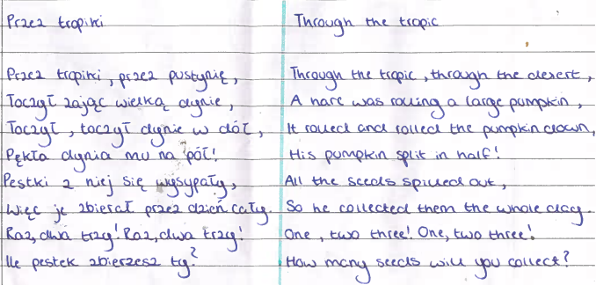
Other Tongue
Ola Marszalkowska (Year 11)
Horizon Community College
Polish
I chose this poem because when I was younger, I had a book of poems, and this is one of the poems I remember. Looking back at it now I believe it’s true meaning was that no matter how difficult something is to achieve or how many times something may break, it is also better to pick yourself up rather than giving up

Slide 34
Empfindsamkeit
Die Sonne scheint am Morgen
und das entzückende Mädchen rennt
Sie zeigt mir ihr berühmtes Lächeln
dass viele Leute kennt.
Die Wärme kommt am Mittag
Als wir laufen durch das Feld
Doch sie gibt mir ihre Jacke
Damit ich mich nicht erkält
Farben zersprengen durch die Höhe
Wir sitzen im Gras unterm Licht
Ihr Kopf auf meinem Herzen als wir reden.
Dann singt sie mir ihr Gedicht.
Obwohl die Sonne untergeht,
Meine Hande werden feucht
Wir unterhalten uns stundenlang
Und ihr Auge leucht
Aber Nacht kommt und wir müssen uns trennen.
Der Mond sieht trauervoll aus.
Wir stehen auf und sie geht
zurück zu ihrem Haus.
Ich bleibe versteckt bei den Blumen,
wo ich mir was vorlügen kann
Aber ich weiss genau, dass
sie ist jetzt mit ihrem Bräutigam
Other Tongue
Amrita Singh-May, (Year 12)
Rochdale Sixth Form College
German
Intense Feelings
The sun shines in the morning
and the charming girl runs.
She shows me her famous laugh
that knows a lot of people.
The warmth comes at midday.
While we're running through the field.
Despite it she gives me her coat.
So that I don't get a cold.
Colours explode throughout the Sky
We sit on the grass under the light
Her head on my heart while we talk
Then she sings me her poem
Although the sun sets
My hands grow clammy
We entertain ourselves for hours
And her eye lights
But night comes and we have to part
The moon looks full of sadness
We stand up and she goes
back to her house
I stay hidden by the flowers
where I can lie to myself
But I know exactly that
she is now with her bridegroom.

Slide 35
What our judges thought…
It is nice reading this poem and listening to it sung in a Gulf variety of Arabic. Although, it can be viewed as a song for very young children, I liked the fact that the student chose it because of the nostalgic feeling it gives them and how it reminds them of their homeland and their early childhood days. Beautiful song!
—Rasha Soliman, Professor in Arabic Pedagogy and Linguistics at the University of Leeds, on Diala Ahmed’s entry
Reading the submissions of poems in Spanish has been such a heart-warming experience. This is a beautiful collection showcasing the amazing creativity of the young people of Leeds. Very impressive entries proving that they live in a truly multilingual city with a thirst and knowledge for languages and such a joy that we can work with different institutions across the city to celebrate languages through poetry!
– Bettina Hermoso-Gomez, Lecturer in Spanish at the University of Leeds, and Director of Routes into Languages Yorkshire and The Humber

Slide 36
What our judges thought…
As a judge for the Mother Tongue, Other Tongue competition, I am constantly amazed and inspired by the incredible talent, creativity, and cultural depth that these young writers bring to their poetry. It’s a real privilege to see young people expressing themselves in a language close to their hearts or venturing into a new language with courage and imagination. This competition not only celebrates linguistic diversity but also fosters a profound respect for different cultures. It encourages children to find their unique voices and connect with others through words. Being part of this competition is a truly meaningful and rewarding experience, showing us all how language can bring people together and inspire us.
--Sofia Martinho, Director of Camões Centre for Portuguese Language at the University of Leeds

Slide 37
Thank you to all schools
who participated:
Horizon Community College
Leeds City Academy
St Margaret’s Primary School
Nicholas Breakspear Catholic School
Rochdale Sixth Form College

Slide 38
Thank you to our judges
and organisers:
Bettina Hermoso-Gómez (Lecturer in Spanish at the University of Leeds, and Director of Routes into Languages Yorkshire and The Humber)
Sofia Martinho (Associate Professor in Portuguese at the University of Leeds, Director of the Camões Centre for Portuguese Language at the University of Leeds)
Louise Earnshaw (Mother Tongue Other Tongue Editor, Leeds Language Week 2024 Project Assistant, and PhD Candidate at the University of Leeds)
Rasha Soliman (Professor in Arabic Pedagogy and Linguistics at the University of Leeds)
Cuie Xu (Lecturer in Korean at the University of Leeds)

Slide 39
Thank you to our partners:
The University of Leeds
Routes into Languages: Yorkshire and the Humber
Camões Centre for Portuguese Language at the University of Leeds
With thanks to Kaye Tew and Becky Swain from the Manchester Poetry Library and Manchester Metropolitan University

